Slide 1
SCT Business Session

Slide 3
Approval of 2024
Business Meeting Minutes

Slide 4
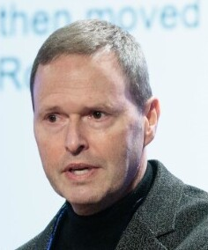
President’s Report
Scott R. Evans, PhD, MS

Slide 5
Year-in-Review

Slide 7
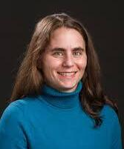
Outgoing Board Member
Denise Esserman, PhD

Slide 8
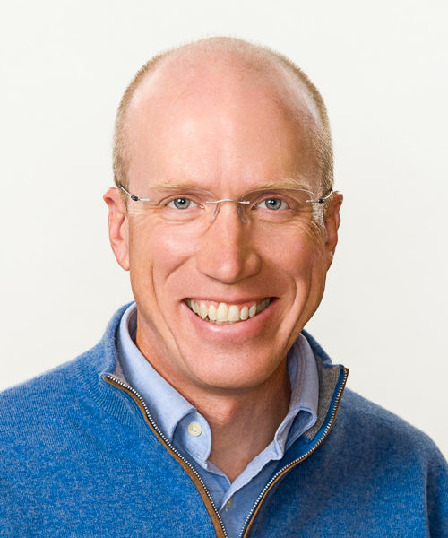
Outgoing Board Member
Ted Lystig, PhD

Slide 9
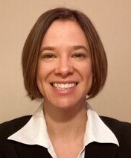
Outgoing Board Member
Juliana Tolles, PhD

Slide 11
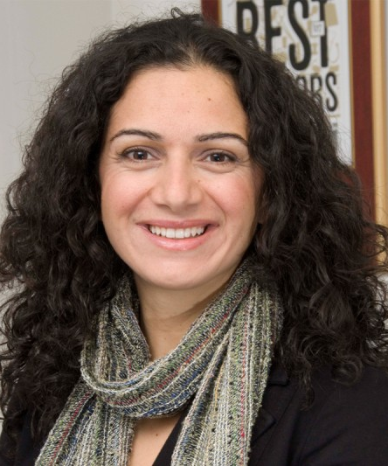
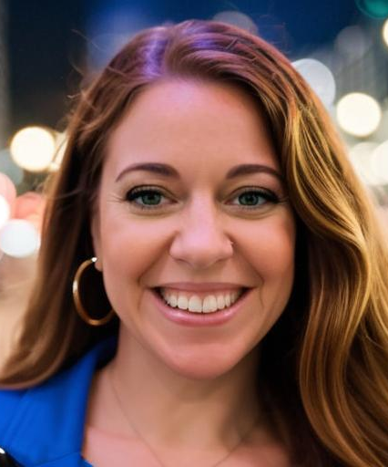
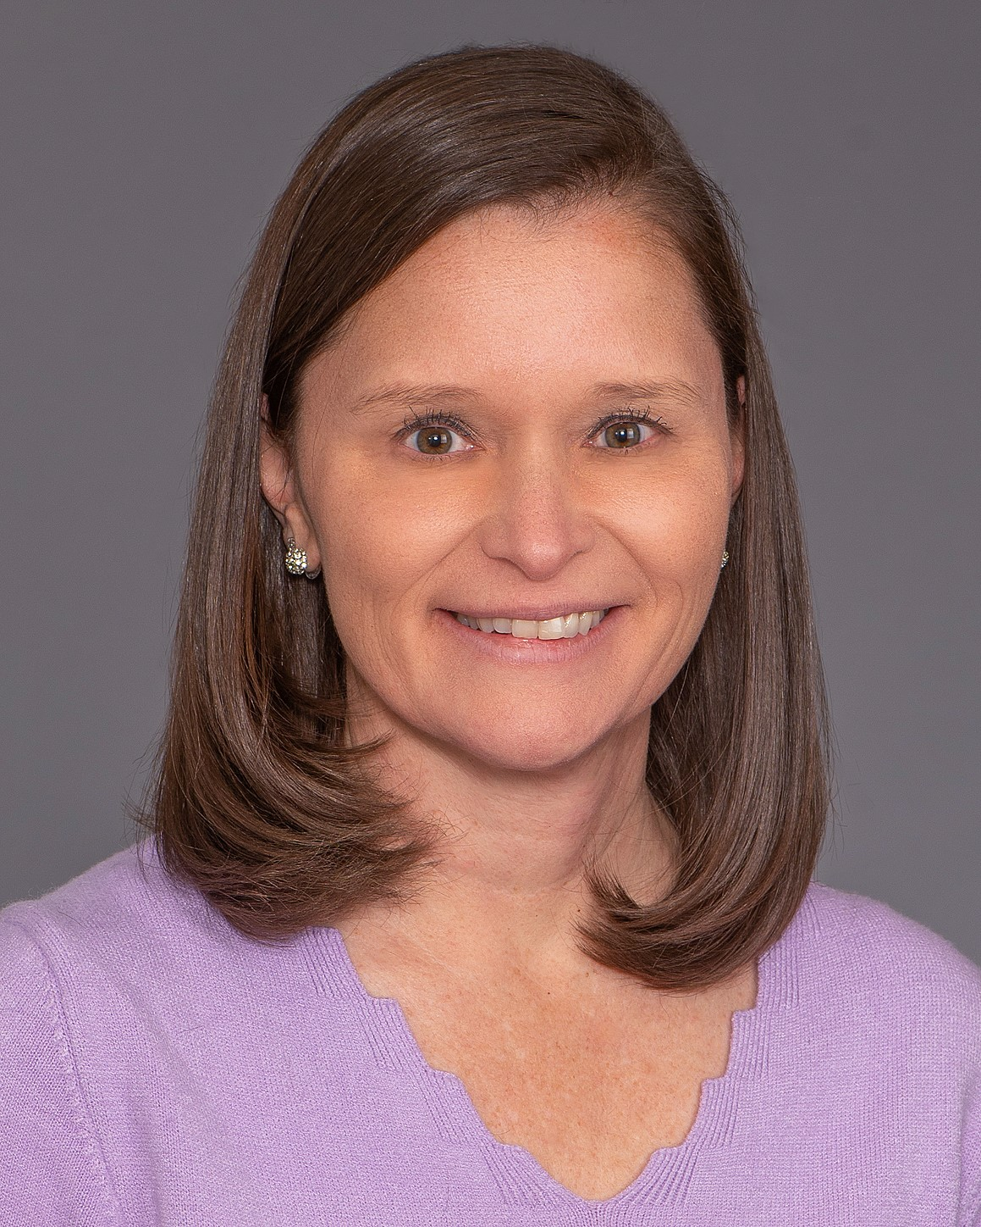
Election Results
President-elect
Alexia Iasonos
Memorial Sloan Kettering Cancer Center
Incoming Board Member
Dikla Blumberg
Rho, Inc.
Incoming Board Member
Sarah Gaussoin
Wake Forest School of Medicine

Slide 12
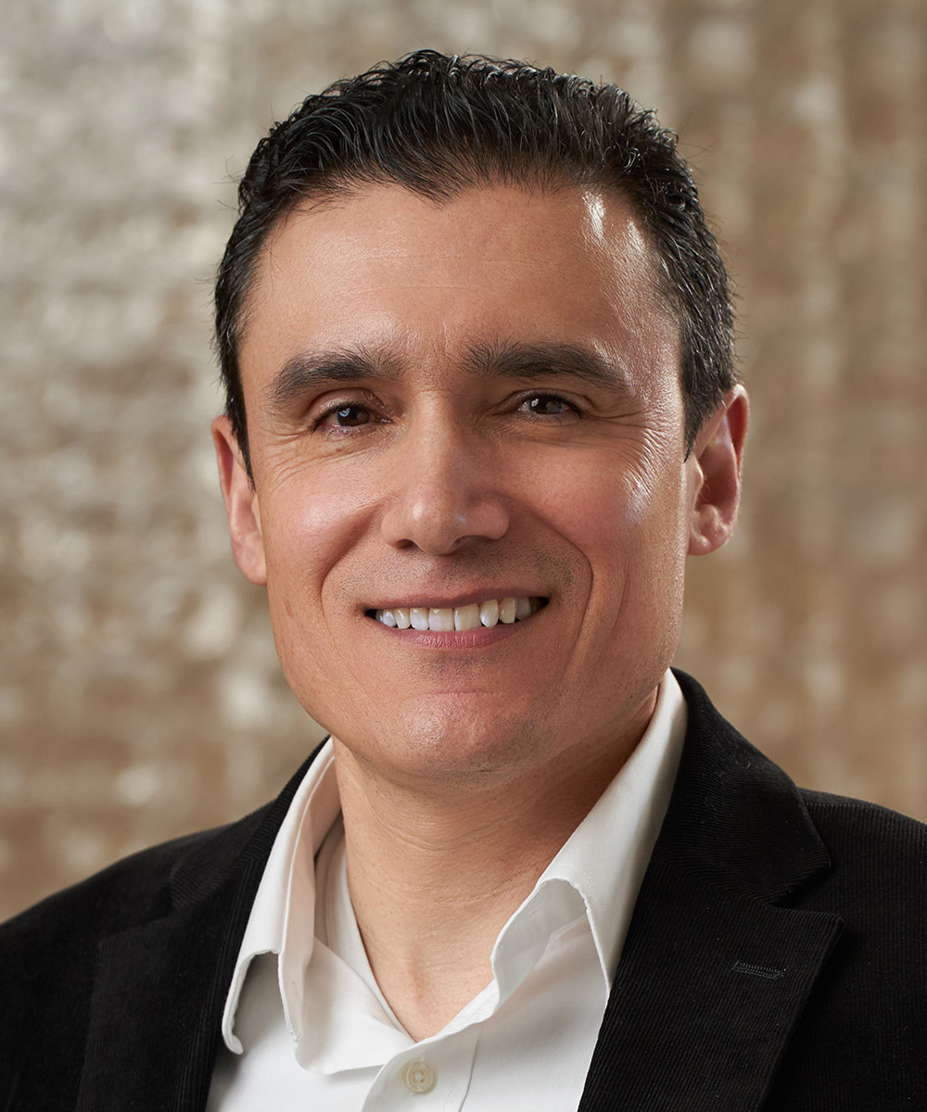
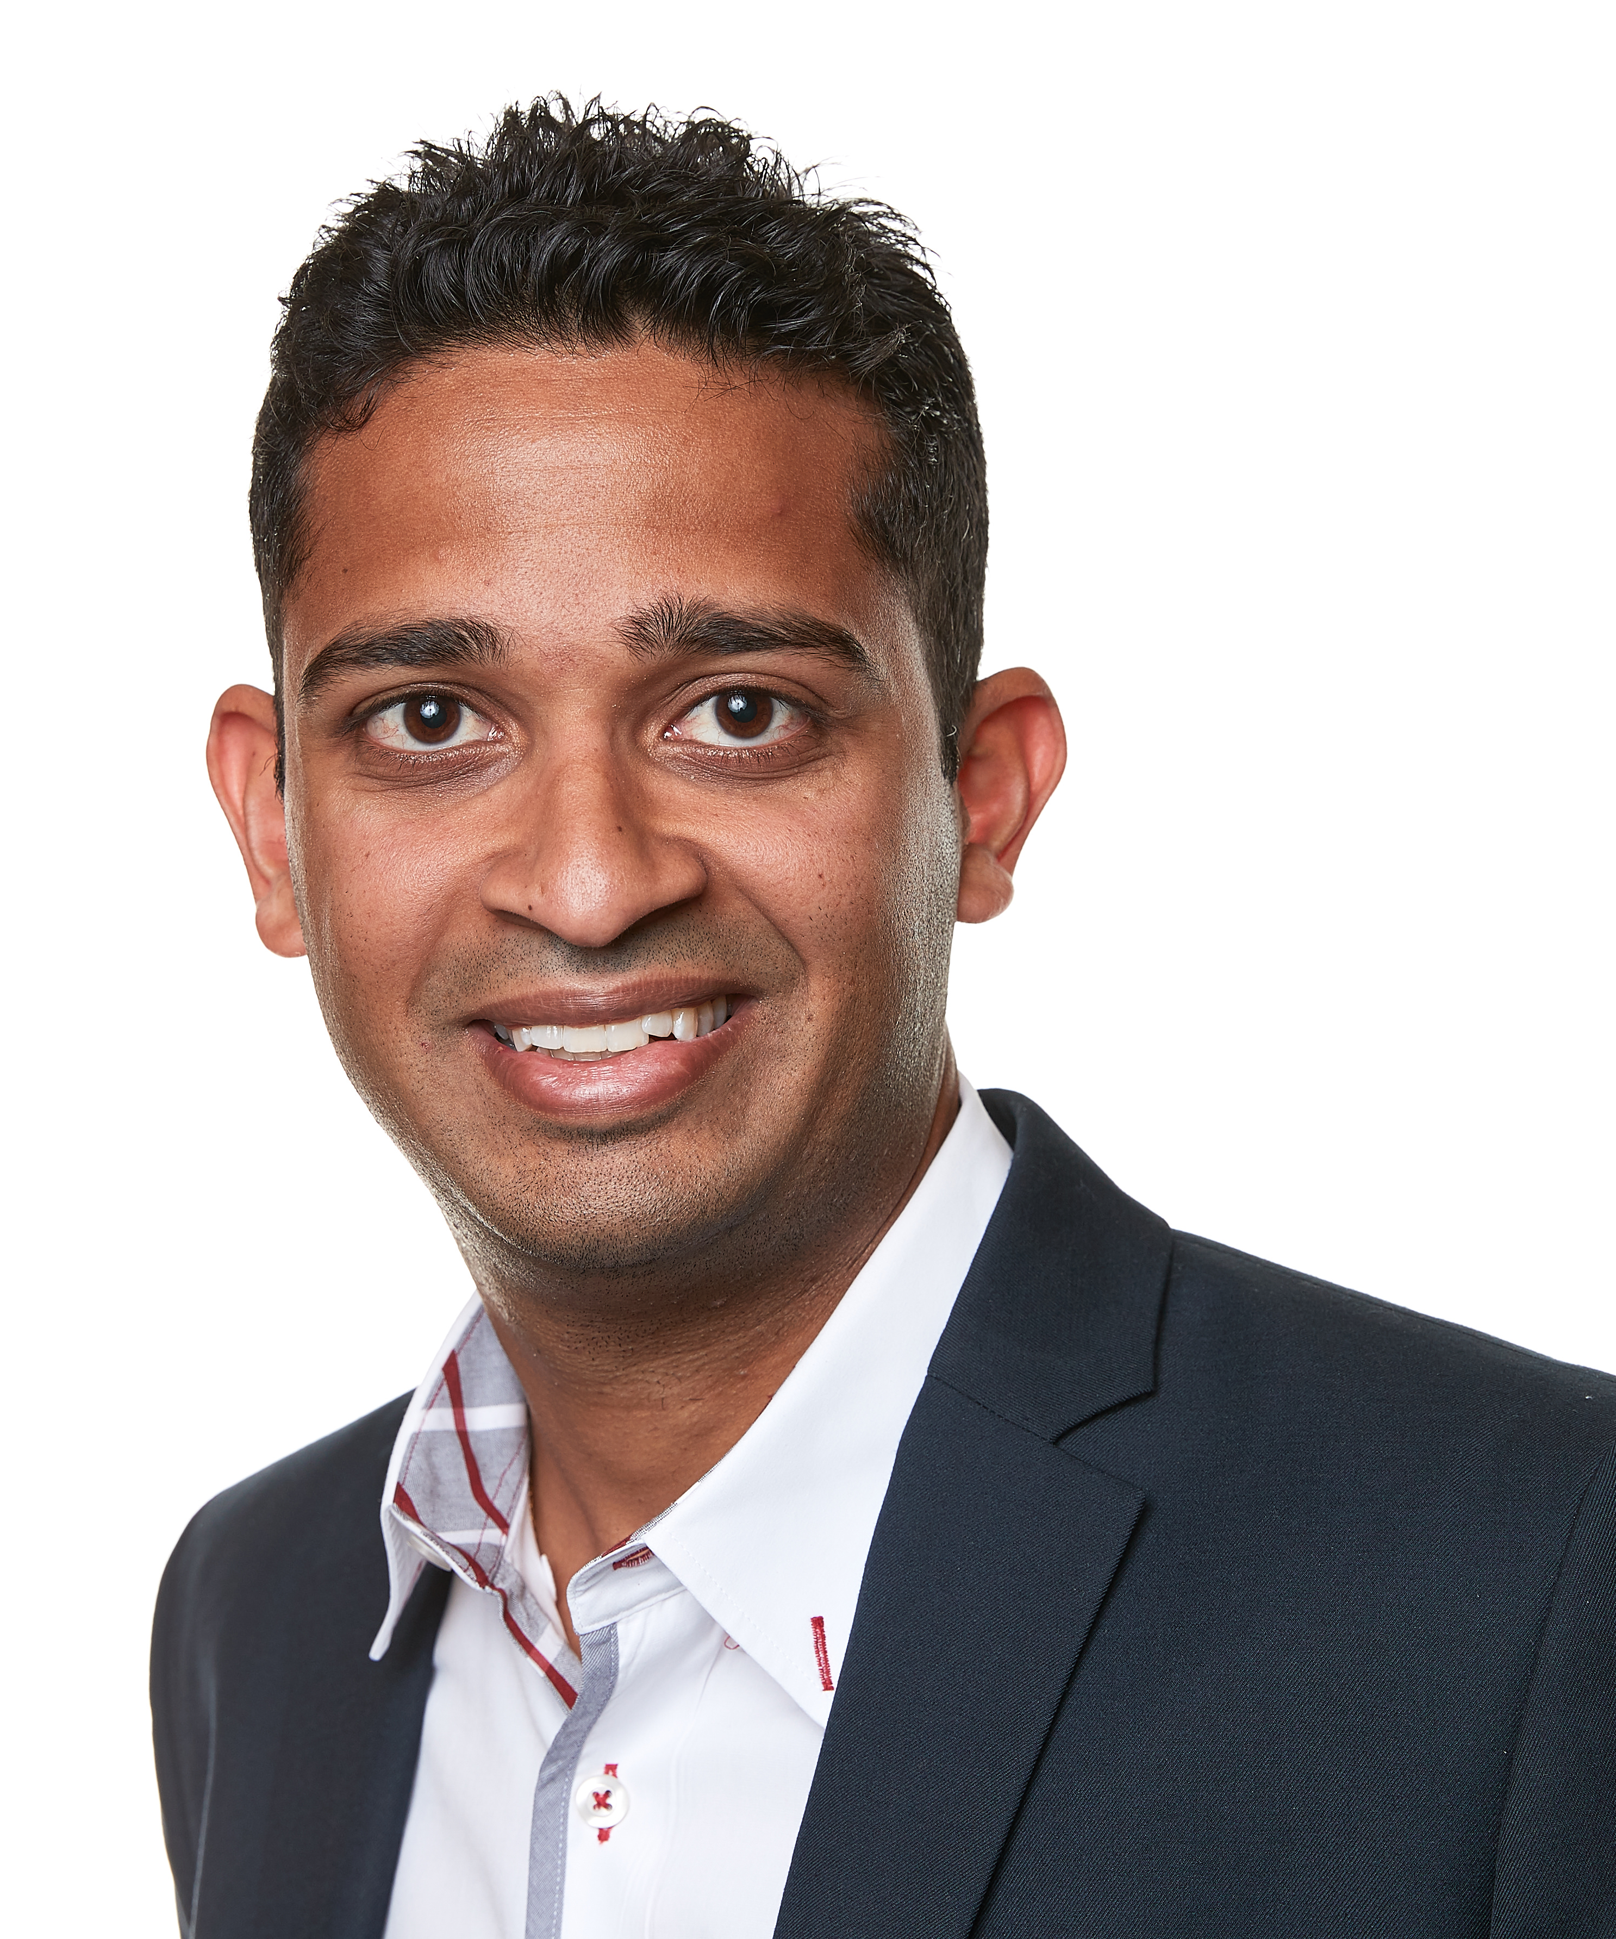
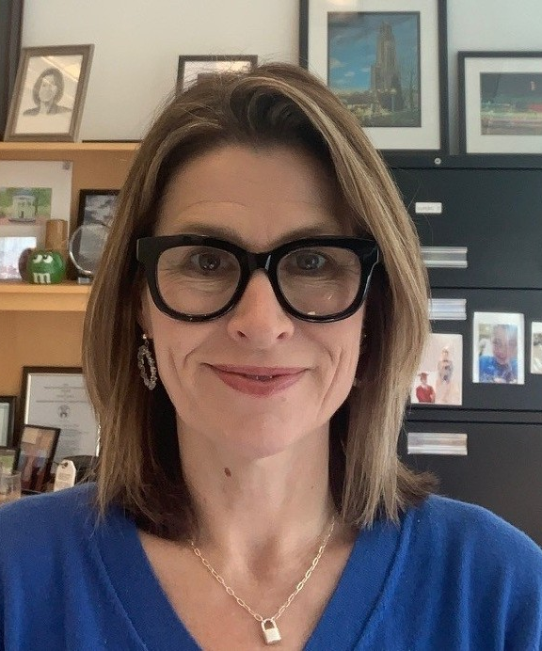
Election Results
Incoming Board Member
Gustavo Jimenez-Maggiora
University of Southern California
Incoming Board Member
Sameer Parpia
McMaster University
Incoming Board Member
Charity Patterson
University of Pittsburgh

Slide 14
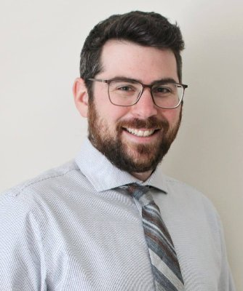
Program Committee Chair
Cory Goldstein, PhD

Slide 16
Education Committee Chair
Sarah Gaussoin, MS

Slide 19
CITI Program, a division of BRANY
Population Health Research Institute
StataCorp
Weave

Slide 21
Financial Report

Slide 22
2024 Year-End Financials
Total Revenue: $772,608 (Budgeted $712,400)
Total Expenses: $702,504 (Budgeted $640,300)
Net Gain: $ 70,104 (vs. Budgeted Gain of $72,100)
Total Net Assets on December 31, 2024: $349,015

Slide 24
Clinical Trials
Journal Report

Slide 25
Aims and Scope
Clinical Trials: Journal of the Society for Clinical Trials is an international peer reviewed scholarly journal that addresses topics of interest to individuals involved in the design and conduct of clinical trials. The primary aim is the dissemination of generalizable knowledge about the design, conduct, analysis, synthesis, history, ethics, regulation and clinical or policy impact of all types of clinical trials.
Note that the journal does not publish articles that essentially reproduce the protocol for an individual clinical trial. Articles that simply report the results of a completed clinical trial are also not considered.

Slide 26
Key 2024 Statistics
405 article submissions
Acceptance rate 22%
Average time to 1st decision 34 days
Current Impact Factor 2.2
Source of published articles
  USA 64%
  UK 11%
  Europe (excluding UK) 8%
  Canada 8%
  Australia/ New Zealand 4%
  South America 2%
  Asia (Japan) 1%
  Africa (Uganda) 1%

Slide 27
Editorial Office – Memorial Sloan Kettering Cancer Center
  Colin Begg – Editor
  Katherine Cheung – Assistant Editor
Deputy Editor Team
  Jonathan Cook UK
  Mithat Gonen USA
  Dan Heitjan USA
  Jonathan Kimmelman Canada
  Ed Korn USA
  Athene Lane UK
  Monica Taljaard Canada
Associate Editors
  Currently there are 64
  46 from USA; 11 from UK; 3 from Canada; 2from Australia; 1 from Holland; 1 from Belgium

Slide 29
Open Discussion/Q&A

Slide 31
Communications
Committee Report

Slide 32
SCT Communications Committee Update
(2024-2025)
Presented by I-Hsin Lin, PhD, Memorial Sloan Kettering Cancer Center
Key Accomplishments
Newsletter Working Group
  Educational Contents Contributed by Invited Experts, Clinical Trials Highlights, Membership Spotlight
LinkedIn Working Group
  New Public SCT LinkedIn Company Page – SCT Webinar Attendance (200%)
  Embedded Live LinkedIn Feed on SCT Website via Juicer
  Featured Clinical Trials Journal Articles
  Integrated Canva for Content Creation
Cross Promotion Strategies across SCT Committees & Global Partners
Social Media Ambassador Program
Executive Committee Approved Guidelines and List of Organizations – Efficient Inclusion & Sustainability

Slide 33
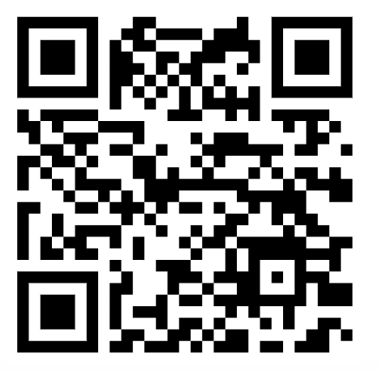
SCT Communications Committee Update (2024-2025) (cont.)
Ongoing Work
Migrating from Private LinkedIn Group – Complete by July 30, 2025
Follow & Share the new SCT Company Page
Tag SCT #SCT2025
Looking Ahead (2025-2026)
Finalize LinkedIn Migration
Strengthen Cross Promotion Collaboration across SCT Committees & Global Partners
Expand Social Media Ambassador Program beyond Annual Meeting
Optimize Newsletter to Reflect Member Need
Acknowledgements
SCT President Scott Evans
Clinical Trials Journal Colin Begg, Katherine Cheung
SCT Office Lisa Aguado, Kevin Bragaw
SCT Collaborating Committees
SCT Communications Committee
  Chair I-Hsin Lin
  Co-Chair Pedro Torres-Saavedra
  Newsletter Working Group Lizhao Ge, Ken Kobayashi, Ator Jallo
  LinkedIn Working Group Sharon Yeatts, Dikla Blumberg, Pam Mangat, Corinne McGill, Julie Qidwai, Abhik Das
  Social Media Ambassadors Alexander Lim, Tony Succar, Ethel Kamuti, Emily Dressler

Slide 35
Thomas C. Chalmers
Student Scholarship

Slide 36
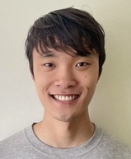
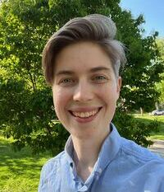
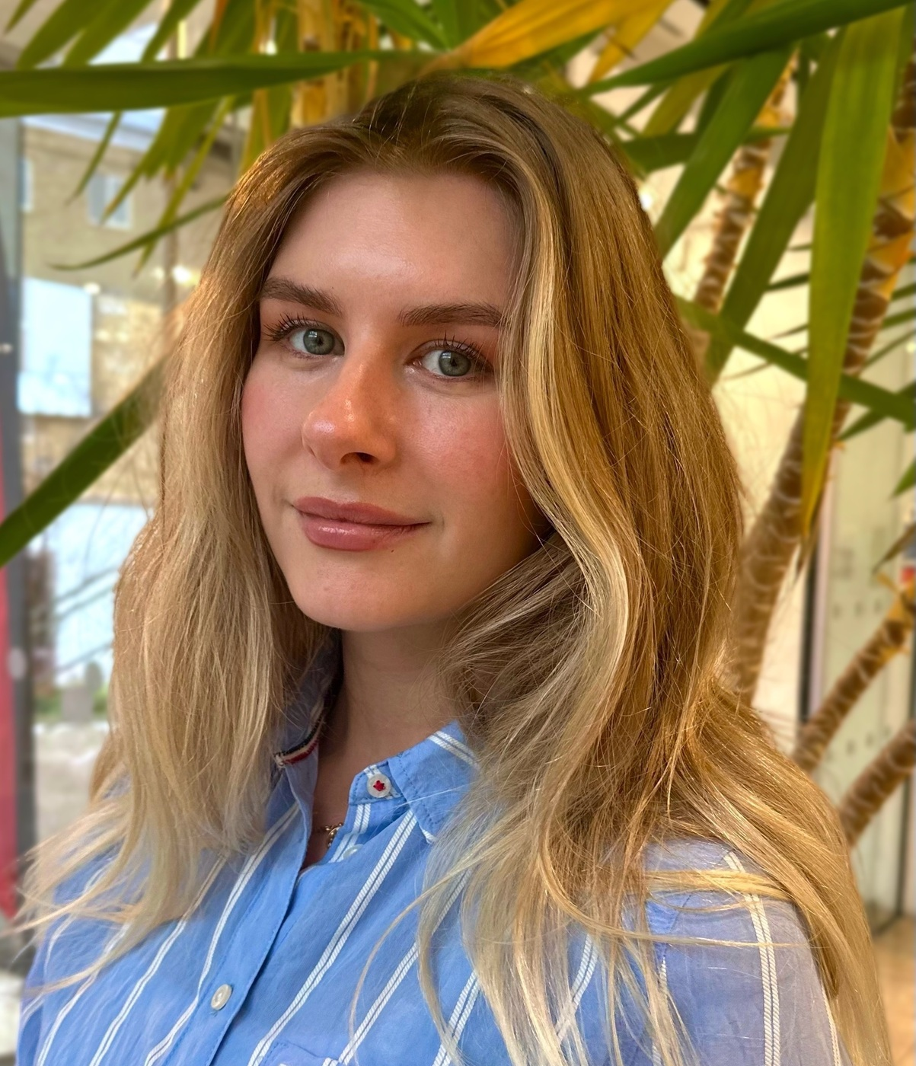
Thomas C. Chalmers Student Scholarship Finalists
Lee Ding
Harvard University
Auden Krauska
University of Wisconsin-Madison
Mollie Payne, MSc
King’s College London

Slide 37
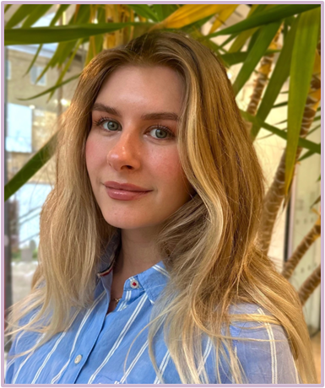
Thomas C. Chalmers Student Scholarship Recipient
Mollie Payne, MSc

Slide 39
Sylvan Green Award

Slide 40
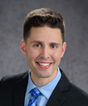
Sylvan Green Award Recipient
Ryan Berry, MD
Harvard College; Michigan State University

Slide 42
ED&I Early-Career Awards

Slide 43
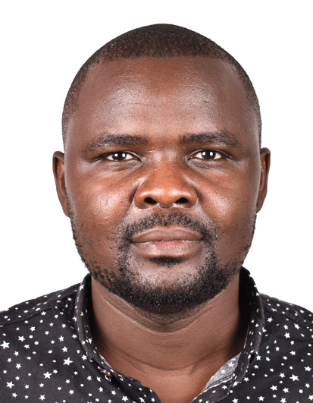
ED&I Early-Career Award Recipient
Isaac Egesa, MSc, PhD (Candidate)

Slide 44
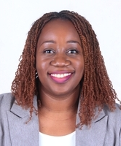
ED&I Early-Career Award Recipient
Ethel Kamuti, MD, MBA

Slide 45
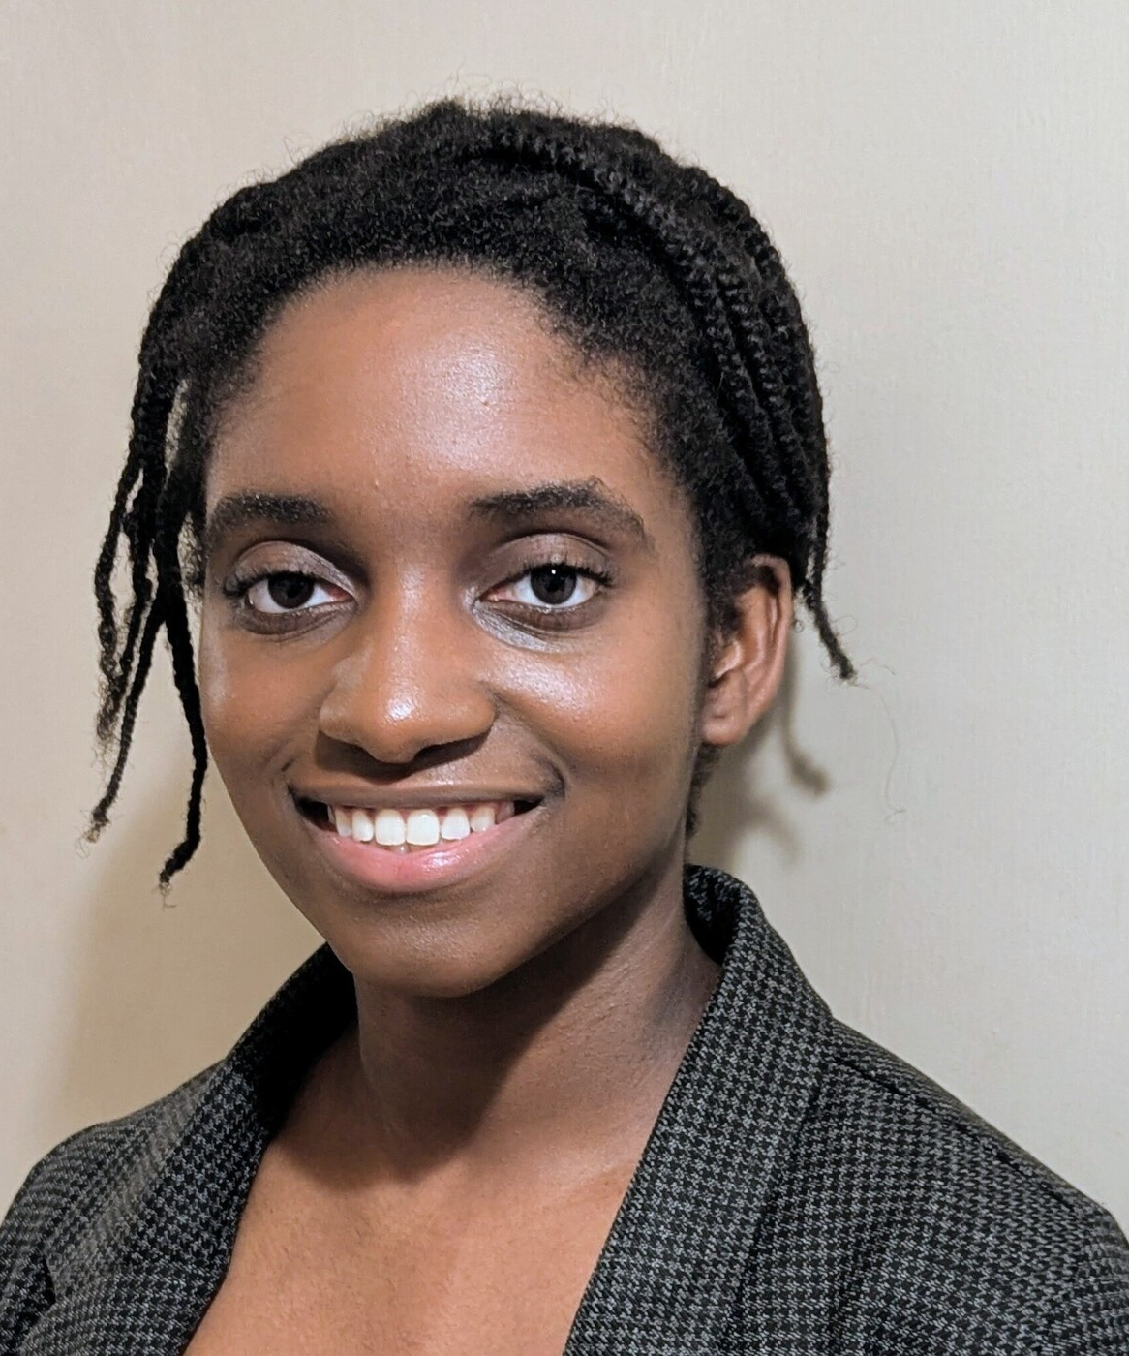
ED&I Early-Career Award Recipient
Memuna Rashid, BA, MSc

Slide 46
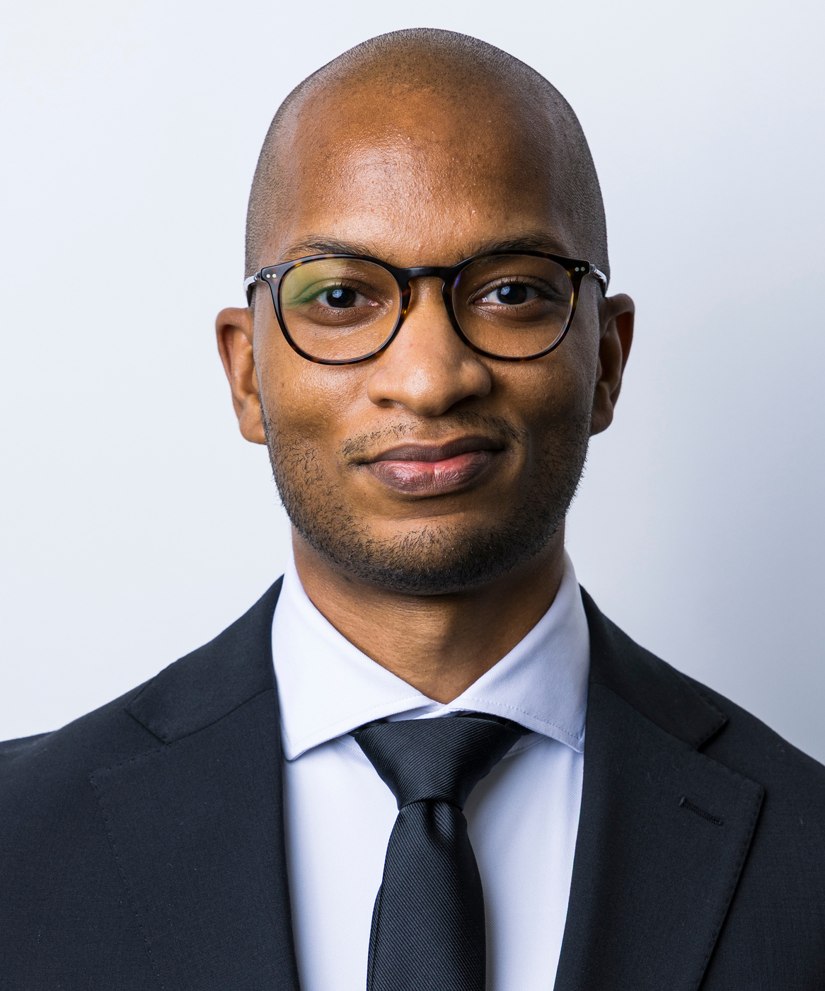
ED&I Early-Career Award Recipient
Alex Thabane, MSc, PhD (c)

Slide 48
Best Poster
Presentation
Award

Slide 49
Best Poster Presentation
“How to Account for Subsequent Anti-Cancer Therapy When Analysing Overall Survival:
A Simulation Study and Practical Example”
Kara-Louise Royle

Slide 51
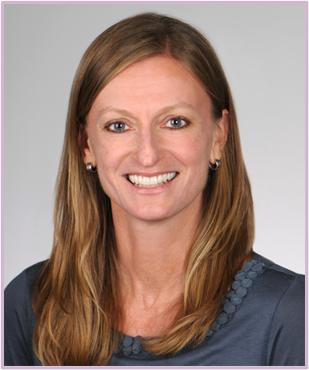
SCT Incoming President
Valerie Durkalski-Mauldin, PhD, MPH

Slide 53
SCT Outgoing President
Scott R. Evans, PhD, MS

Slide 55



8th International Clinical Trials
Methodology Conference
Save the date
14 – 17 September 2026
ICC, Birmingham, UK

Slide 57



